Slide 1
HR ANALYSIS
GROUP – 3

Slide 2
INDEX
INTRODUCTION
KPI -1 : Average Attrition rate for all Departments
KPI -2 : Average Hourly rate of Male Research Scientist
KPI -3 : Attrition rate Vs Monthly income stats
KPI -4 : Average working years for each Department
KPI -5 : Job Role Vs Work life balance
KPI -6 : Attrition rate Vs Year since last promotion relation
Excel Dashboard
Tableau Dashboard
Power BI Dashboard
SQL
Suggestions
Conclusion

Slide 3
INTRODUCTION
HR analytics allows HR professionals to make informed decisions and create strategies that will benefit employees and support organizational goals. This has a significant impact on organizational performance, leading to rise in business productivity, and decrease in attrition rates, and increase recruiting efficiency.
It is the method of getting a better understanding of the people within an organization and how well the human resources team is performing.

Slide 4
KPI - 1 : Average Attrition rate for all Departments
From all the departments, Attrition is higher in the Research department which is 51.21%
Least Attrition: Hardware department which is 49.44%
Higher male attrition: Software department 51.52%
Higher female attrition: Research department 51.72%
Overall Attrition rate: 50.21%

Slide 5
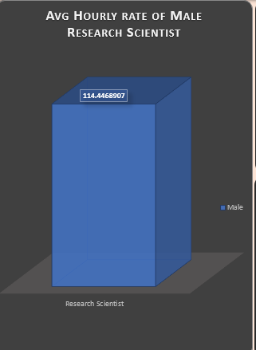
KPI - 2 : Average Hourly rate of Male Research Scientist
A male research scientist earns about an average of $114 per hour.

Slide 6
KPI - 3 : Attrition rate Vs Monthly income stats
Higher Attrition rate of 17.39% between monthly income 42.5K to 50K,And 17.05% between income 17K to 25.5K
Lower attrition rate of 14.95% for monthly income lower than 10K
Total Attritions : 25105

Slide 7
KPI - 4 : Average working years for each Department
Higher average of working years for departments
Hardware 6.01 years
Research & development 5.91 years
Lesser average of working years for sales Departments 5.84 years
All departments are having low average of working years except hardware and research & development.

Slide 8
KPI - 5 : Job Role Vs Work life balance
Healthy Work life balance for job roles
Healthcare representative 10.12%
Research Scientist 10.11%
Manager 10.06%
Developer 10.02%
Sales representative 10.04%
research director 10.03%
Weak Work life balance for job roles
Human Resource 9.88%
Laboratory technician 9.70%
Manufacturing director 9.96%
Sales executive 9.99%

Slide 9
KPI - 6 : Attrition rate Vs Year since last promotion relation
Job roles with Higher attrition for high average values of last promotion
Job role | Average Yrs since last promotion | Attrition
Manager | 6.0 | 50.42%
Sales Representative | 6.0 | 50.43%
Job roles with lower attrition for low average values of last promotion
Job role | Average Yrs since last promotion | Attrition
Healthcare Representative | 5.8 | 50.27%
Research scientist | 5.9 | 48.91%

Slide 10
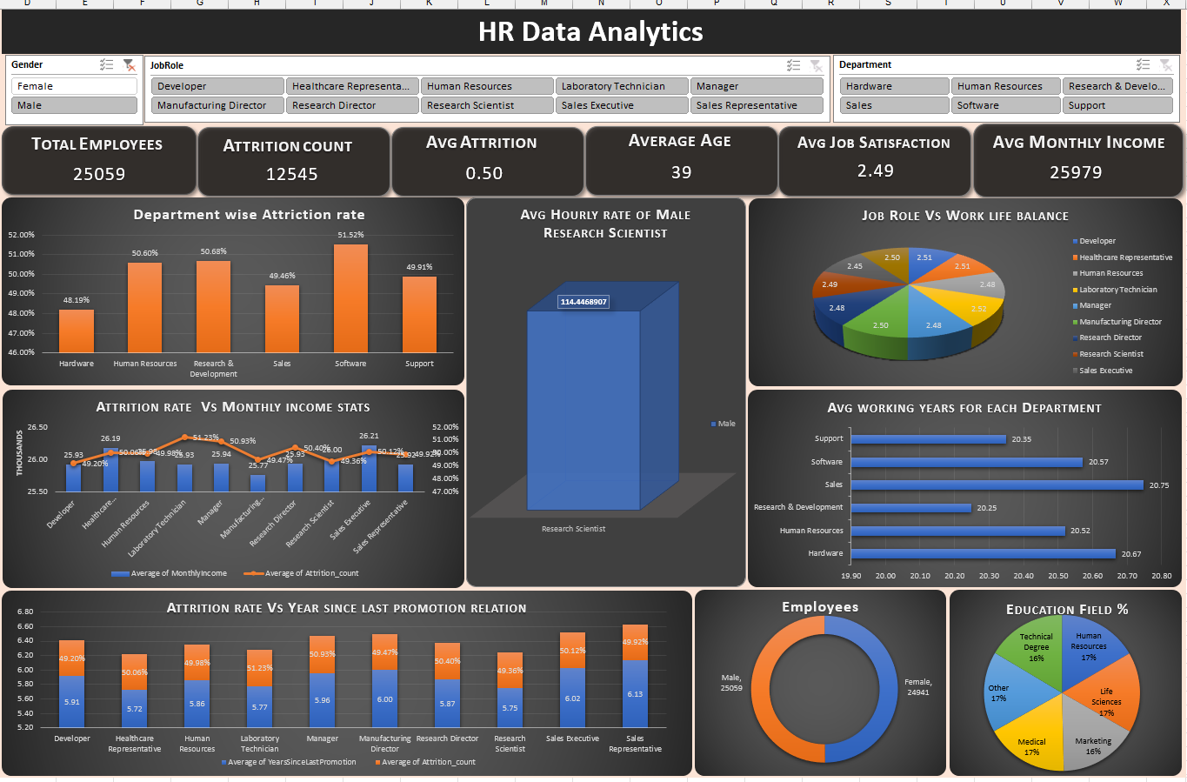
EXCEL DASHBOARD

Slide 11
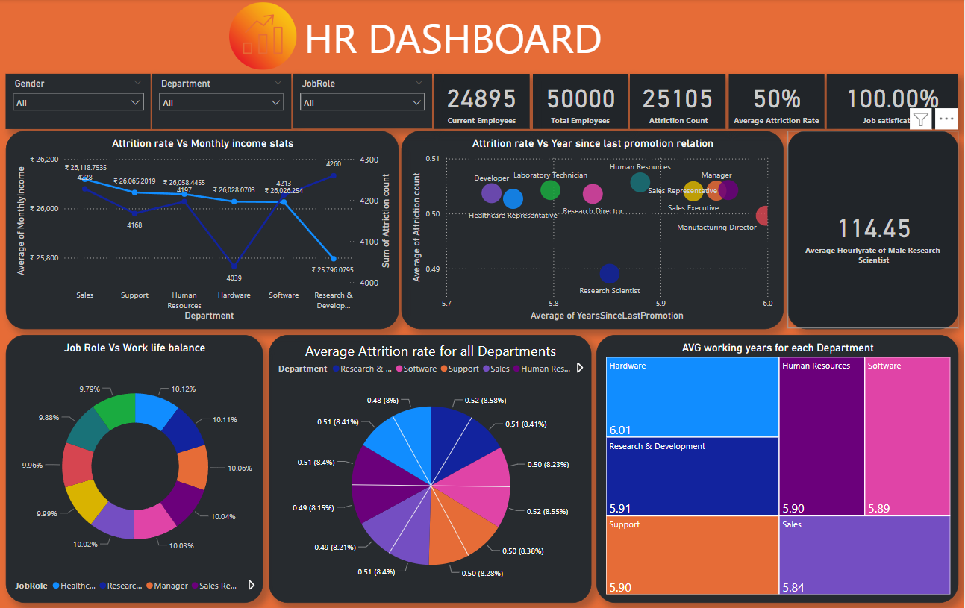
POWERBI DASHBOARD

Slide 12
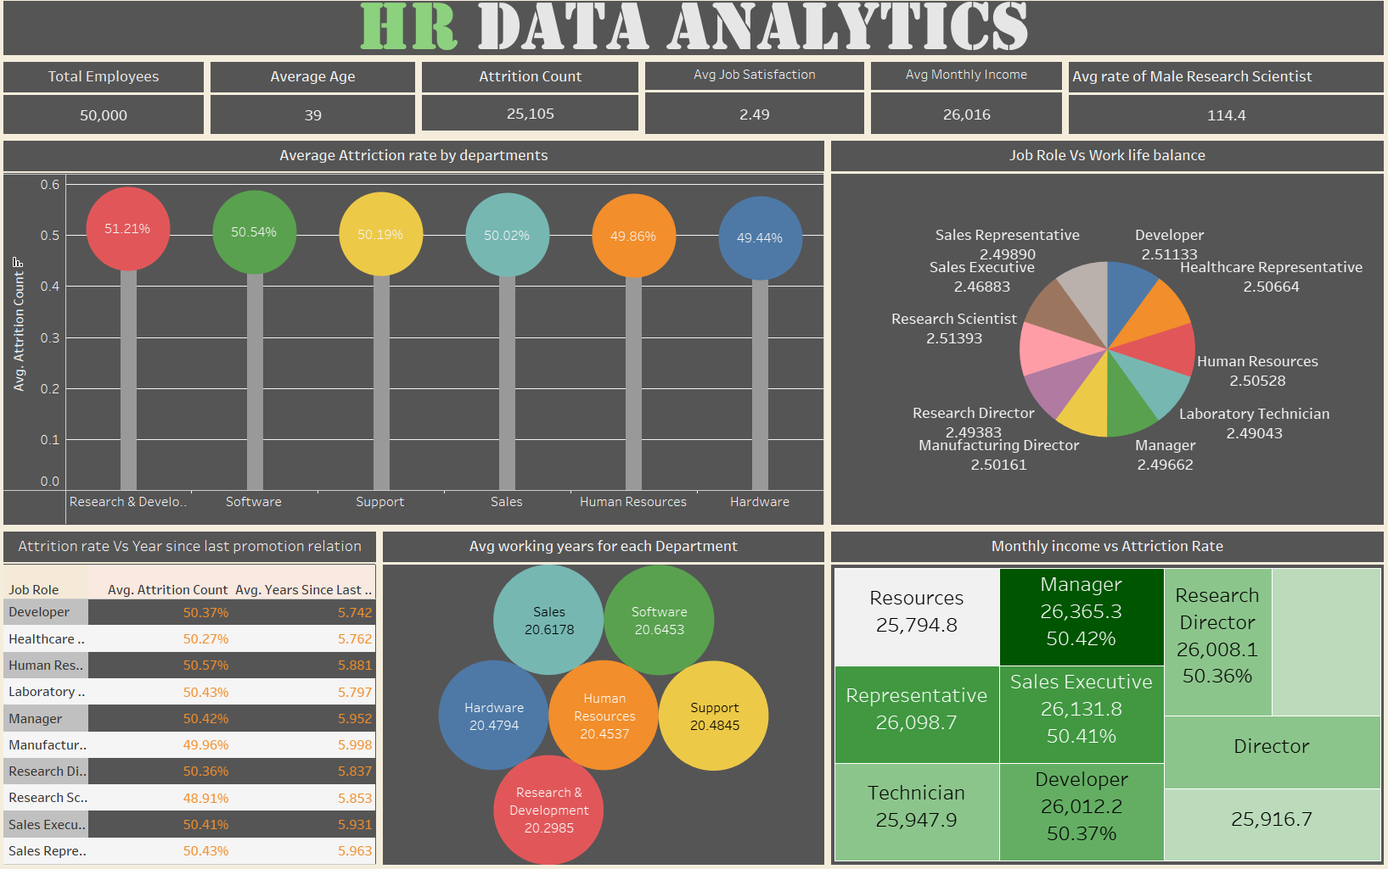
TABLEAU DASHBOARD

Slide 13
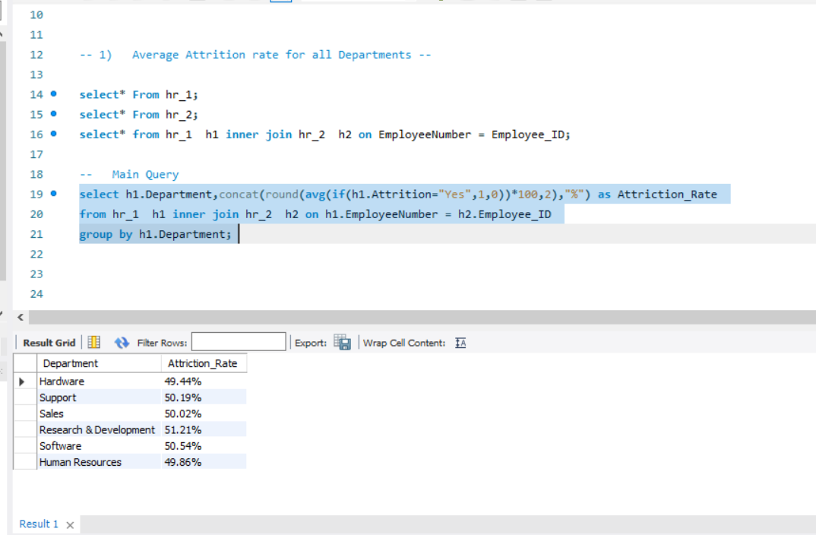
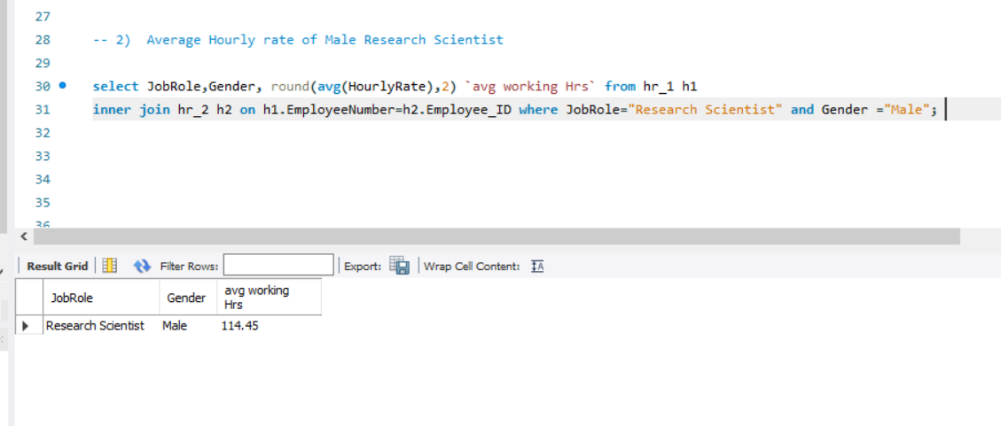
SQL QUERY
KPI -1 : Average Attrition rate for all Departments.
KPI -2 : Average Hourly rate of Male Research Scientist.
Job Role | Gender | Avg working hours
Research Scientist | Male | 114.45
Department | Attrition rate
Hardware | 49.44%
Support | 50.19%
Sales | 50.02%
Research & Development | 51.21%
Software | 50.54%
Human Resources | 49.86%

Slide 14
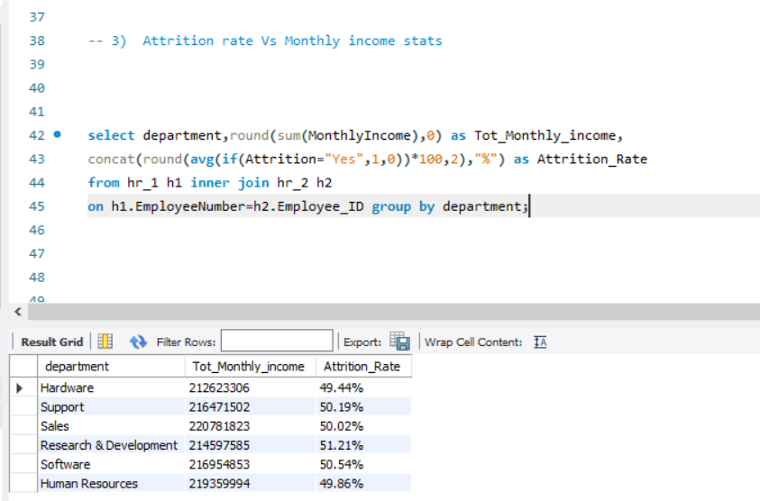
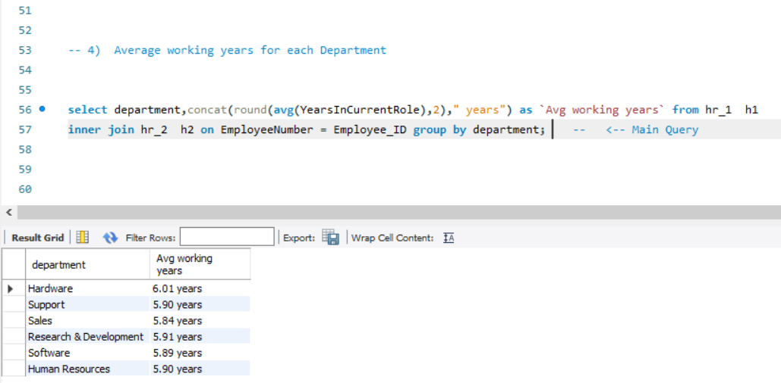
SQL QUERY
KPI -3 : Attrition rate Vs Monthly income stats.
KPI -4 : Average working years for each Department.
Department | Total Monthly Income | Attrition Rate
Hardware | 212623306 | 49.44%
Support | 216471502 | 50.19%
Sales | 220781823 | 50.02%
Research & Development | 214597585 | 51.21%
Software | 216954853 | 50.54%
Human Resources | 219359994 | 49.86%
Department | Avg working years
Hardware | 6.01 years
Support | 5.90 years
Sales | 5.84 years
Research & Development | 5.91 years
Software | 5.89 years
Human Resources | 5.90 years

Slide 15
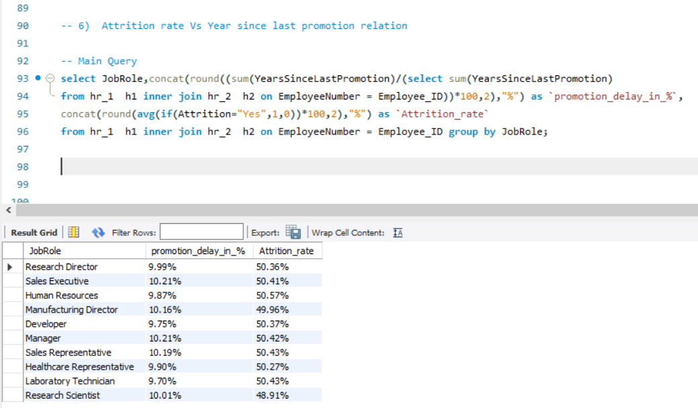
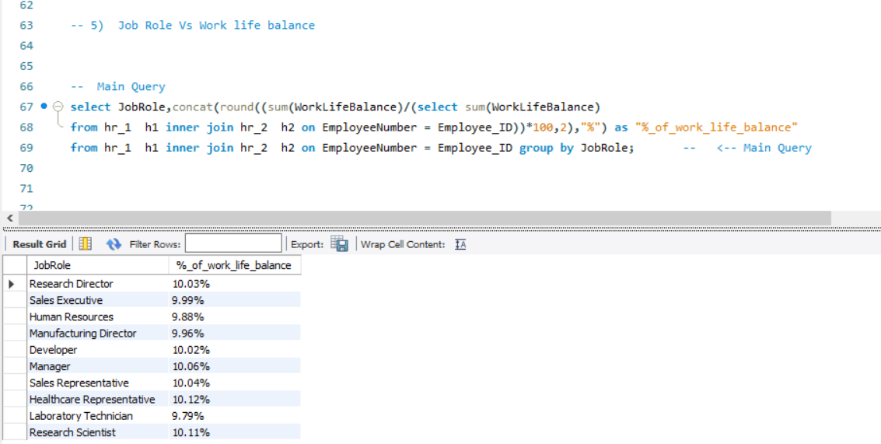
SQL QUERY
KPI -6 : Attrition rate Vs Year since last promotion relation.
KPI -5 : Job Role Vs Work life balance.
Job Role | % Of Work Life Balance
Research Director | 10.03%
Sales Executive | 9.99%
Human Resources | 9.88%
Manufacturing Director | 9.96%
Developer | 10.02%
Manager | 10.06%
Sales Representative | 10.04%
Healthcare Representative | 10.12%
Laboratory Technician | 9.79%
Research Scientist | 10.11%
Job Role | Promotion delay in % | Attrition rate
Research Director | 9.99% | 50.36%
Sales Executive | 10.21% | 50.41%
Human Resources | 9.87% | 50.57%
Manufacturing Director | 10.16% | 49.96%
Developer | 9.75% | 50.37%
Manager | 10.21% | 50.42%
Sales Representative | 10.19% | 50.43%
Healthcare Representative | 9.90% | 50.27%
Laboratory Technician | 9.70% | 50.43%
Research Scientist | 10.01% | 48.91%

Slide 16
SUGGESTIONS
We can reduce employee attrition and retain employees by overcoming low pay, addressing poor work-life balance, creating career growth opportunities, offering flexible work arrangement.
Despite of high income attrition are more here which indicates income is not the only sole for happening attrition, and need to focus on other factors like job satisfaction, work life balance, career development opportunities which are equally important in retaining employees.
We can improve the working years of employees by lower overall stress, offering career growth opportunities
Should focus on improving work life balance by promoting boundaries, prioritizing task, encourage time off, by encouraging breaks and downtime.
Attrition can be reduced by making improvement in reducing delays in the employees promotions which motivates employee to stay long term with organization.

Slide 17
CONCLUSION
Human Resource (HR) Analytics is a crucial tool that enables HR professionals to make data-driven decisions related to employee behavior, performance, and engagement to improve organizational performance.
Working on such data helped us in understanding various HR metrics and concepts. This knowledge enables us to deliver proper insights which guides HR in making decision which contributes in both employee satisfaction & business growth.

Slide 18
Thank
You

